Slide 1
Multiple-lable Recognition Dog & Cat

Slide 2
Something New

Slide 3
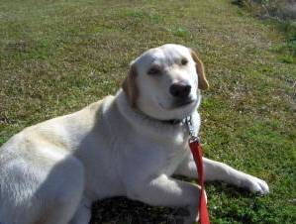
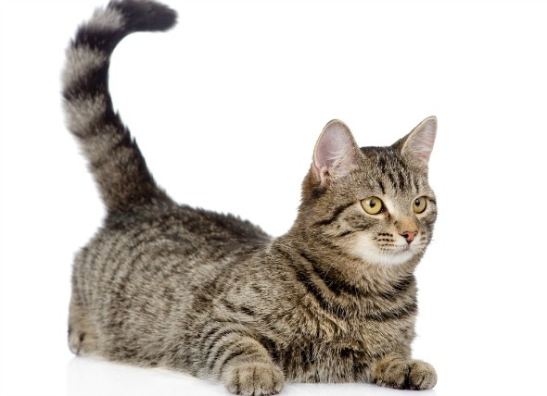
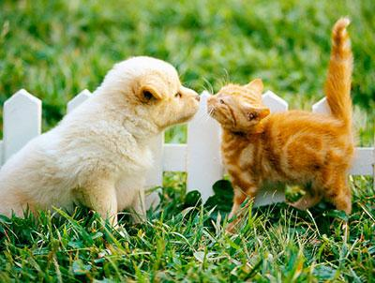
OLD
(1, 0 ,0) | (0, 1, 0) | (0, 0, 1)
NEW
(1, 0) | (0, 1) | (1, 1)

Slide 4
Tools

Slide 5



Tensorflow
CNN
(convolution Neural Network)
Inception v3

Slide 6


Fatkun
Sigmoid

Slide 7
Result

Slide 8
3
classes
300
Picture/
Class
in training
30
epoch
3000
Iterations/
epoch

Slide 9
300
Pictures
In test
84.4%
accuracy

Slide 10
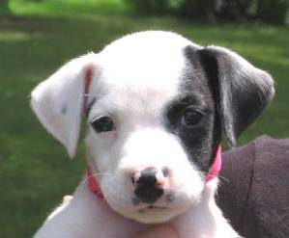
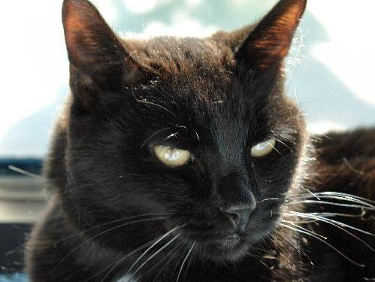
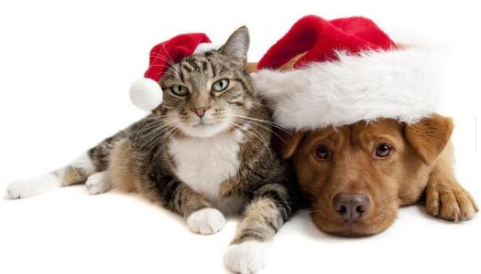
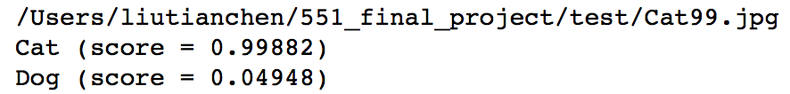

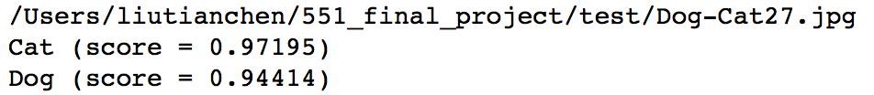

Slide 11
